Slide 1

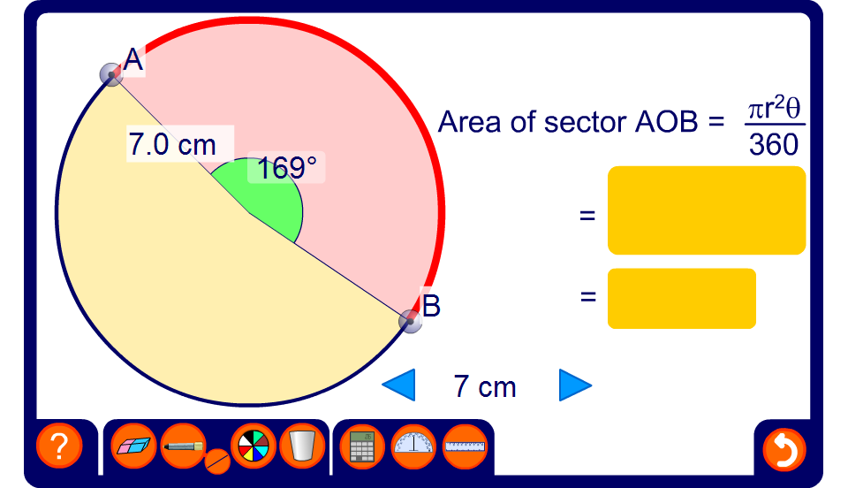


Finding the area of a sector
Notes:
Reveal the size of the angle and the length of the radius and ask pupils to find the area of the sector.
Change these values to give a new problem.
Extend the activity by hiding the angle at the centre of the circle. Reveal the area of the sector and ask pupils to find the unknown angle using the formula.

